Slide 1

The magic of application modeling
Introduction to Juju
Notes:
Hello my name is Matt and I am really excited to be here. I am a software engineer who works for Canonical.
I wanted to thank IEEE and Chuck Cole for inviting me to talk about what we are doing at Canonical around application modeling

Slide 2
scarcity to abundance
Notes:
I am going to use a common theme in this talk about when things that are scarce become abundant. You will see those words come up throughout the talk.
How that has changed modern software and cloud computing.
Let’s talk about some concepts that you may be familiar with. How does an electrical engineer create a model?

Slide 3
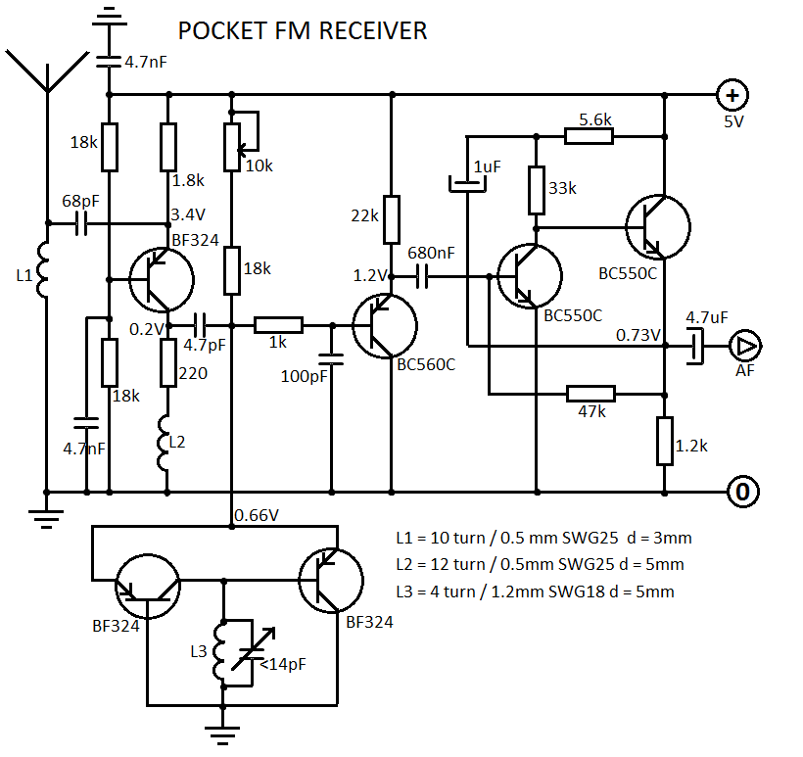
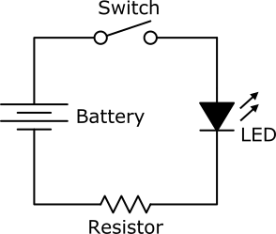
How did electrical engineers create models?
Notes:
Years ago Electrical Engineers created products using the basic building blocks of the technology (resistors, capacitors, diodes, transistors, etc).
These are called Discrete Circuits.
When the project grew larger they started writing circuit diagrams. Complex things are possible, but they often took a long time to design and connect each component by hand.
This software analogy to this is writing your own program in C.

Slide 4
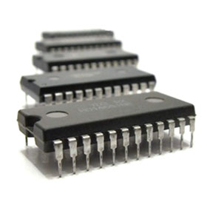
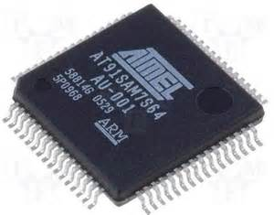
Next came Integrated Circuits (IC)
Notes:
Many years later Integrated Circuits (IC) or microchips came out. One chip contained very complex logic that was smaller than a Discrete Circuit made from independent components.
ICs were mass produced and Engineers had an abundance of chips to choose from. Each chip was a well defined design (standard) that had been tested. These common components were a huge improvement over manually assembled discrete circuits. An Engineer could go to a store and buy components to make smaller and more complex projects.
However, the engineer has to know the inputs and outputs and how to hook everything up correctly.

Slide 5
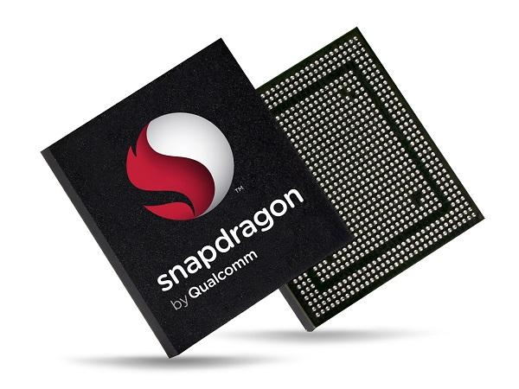
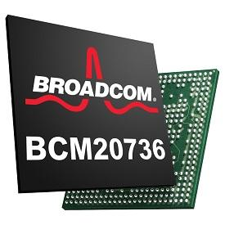
Then System on Chip (SoC)
Notes:
System on Chip (SoC) is an integrated circuit that integrates all components of a computer into a single chip. CPU, Memory, GPU, cellular radios, GPS, etc.
Technically this is just a really big IC. But the point is SoC encapsulates a whole system on one chip.
SoC enabled engineers to build many wonderful things like, cellphones, tablets and this raspberry pi.

Slide 6
The same thing that happened in hardware
is happening in software
Notes:
Software is abundant.
What has enabled this? The Open source movement. In response to a lack of inexpensive or free software.
There is so much software out there now and people can have their pick.
Models are needed to put the software together.
No one person can understand the deep details of everything.

Slide 7
the phase change of modern software
scale, topology, momentum
Notes:
Modern software is hardly ever contained on one system.
With the abundance of resources we put different processes on different servers to gain reliability and tolerance to failure.
It would be hard to find modern production software that runs on one system any longer.
Hundreds or thousands of applications that all need to be connected to each other to form a solution or a product.

Slide 8
software is abundant
Making writing software less necessary
Notes:
What changed? Software used to be scarce. Now it is abundant.
I grew up in a time where software was scarce. It was very expensive. I am sure many of you can remember there was not much software and it was expensive.
With the open source movement, we now live in a time where software is pervasive, and largely free.
With the abundance of software. We have to change the way we manage software, find the software and how we can use that software.
Example:
Music used to be scarce, when it became available people horded it on our own computers, now we sign up for a streaming service and have access to larger and larger music databases. The problem becomes how do we manage all that music? Choosing it, finding it, and curating it.

Slide 9
vi main.c
We used to write our programs from scratch
Notes:
We use to write compilers just so we could _write_ the programs!
Writing programs is fine just not the best use of your time. Occasionally you do need to write your own software, but the trend is less and less often because these days people have more choice of multiple solutions for the same requirement. Need to host a web server? Apache/Nginx, Need a relational database? Mysql/Postgresql, Need a distributed database? Mongodb/Cassandra, the list goes on and on.
This is phase similar to the discrete circuits. Software engineers are building things with the primitives of their technology.
Do electrical engineers still build discrete circuits? Maybe, but not very often,

Slide 10
./configure; make; sudo make install
Install someone else’s project
Notes:
Go out to places like github and download the projects, compile them for your system and install them.
It is a force multiplier to use code that has already been written, many times faster than writing the code yourself. You find someone who did something you need done and install it on your system.
Think of the Integrated Circuit example again.
You can pull components off the shelf and use them in your project, you just need to know how to wire them up.

Slide 11
sudo apt-get install
Install packaged software
Notes:
You are about 100x more productive using packaged software vs. writing your own software.
When package managers get it right it is a beautiful thing, I can be up and running a new piece of software in seconds or minutes with no configuration or fiddling with it.
With packaged software users do not know or care what language it was written in, or what tools were used to create the final product. They do care if it works and if it is all completed for them, like a System on Chip.
I love packaged software so much, it is a shame you can not apt-get across many different servers in the cloud.

Slide 12
the new software is too big for apt-get
Notes:
Modern software is often composed of several pieces or different services that can run on completely different servers.
An example is Open Stack which is several different services that can be combined in different ways for different features.
The old package managers of the past can not keep up.

Slide 13
Install software on the multiple machines in the cloud
What does that well?
Notes:
I can install software on my machine and a handful of other machines, but when it comes to tens, hundreds or thousands I am out of my depth.

Slide 14
the operations team
uses automation to install things in the cloud
Notes:
With cloud computing a company can have thousands of mission critical systems. They may all be running different software, different OSes.
There are several configuration management tools that help with that, Puppet, Chef, Ansible.
Sometimes the development and operations team combines their responsibilities and roles to form something called DevOps.
They are the heroes that wear a pager and get woke up in the middle of the night when a server goes down.
They go to great lengths to keep the servers running and automate those when necessary.

Slide 15
scarcity has shifted from code to operations
Notes:
Software is only getting more complex. The knowledge of how to operate all that software at scale is scarce.
Who here could install/configure OpenStack from scratch, Kubernetes, Apache Hadoop?
Could you do that with HA? Could the software scale up and down?
Knowledge and experience to do setup these types of systems is pretty rare and specialized. Do you need to keep hiring experts?

Slide 16
Build a solution from other pieces of software
But everyone is doing it differently
Notes:
You can do this today, many organizations glue together other software to make their special thing. But if you are all using the same database you _could_ be using the same operations as well.

Slide 17
Industrial Duct Tape
Everyone pull in dependencies and grab your adhesive
Notes:
Run a web server, connected to a database, and offer some kind of on-line service
Ecommerce software
Logistics software
Supply chain management
Inventory management
Accounting software

Slide 18
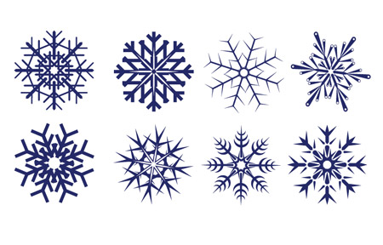
stop building “snowflakes”!
To reach the next level we must
Notes:
The snowflake that I am referring to is the custom built one-off application that makes it very difficult for someone else to reuse your operations. You are going through the work of making the software work for you but can others use it on different servers, different clouds?
Do you know what I mean by snowflake? - Where each operations process is unique custom tailored to either your cloud or hardware. Some organizations even build solutions with the same components, but since they don’t talk with the other group they may not be aware of it, and not reuse the work already done.
Is the snowflake repeatable (automated)?
Does the snowflake scale?
Is it properly backed up with high availability?
You are probably automating things already. But ask yourself this - how many times have you scripted or automated the same thing, for different circumstances?
For example, you may have a puppet or chef script to deploy something in production. But you deploy it in test every day too. And on developers laptops. And each time you use a different bit of automation.
Juju is a higher-level tool. With Juju you can reuse your Chef or Puppet or Ansible scripts, everywhere. On laptops, on clouds, in virtual machines and on bare metal servers.
Juju allows you to crowd-source your operations for all the things where just being brilliant is good enough. Leaving you plenty of time to focus on the things where you want to be absolutely the best in the world.

Slide 19
the solution is reusable, open source operations
Notes:
“build or buy” is normal consideration for application software but for operations, we always seem to “build”, even if we outsource to an integrator, it’s still a custom snowflake after they integrate it
If we could do the same thing for operations that open source did for software. Everyone could use the software with the same operations! The operations would be quite good, robust, be able to scale and be useful to many different people.
Where your team could pick from some tested, verified, best practices way of installing and managing software.

Slide 20
features
re-use quality
cost
...reuse also drives cost down and features in
The more people share the cost of design and implementation, the lower the cost to each of them becomes.
And the more people are using a piece of code, the more capable - feature rich - that code becomes.
Now, imagine re-using the MySQL operations code of a hundred other companies. You’d have the most secure, most resilient, most adaptive, most re-usable implementation that works on the most clouds.
We call that a charm, a reusable nugget of operations that encapsulates automation (Chef, Puppet, Ansible, Salt scripts) in a way that “just works” everywhere from clouds to laptops.
Notes:
What if you could get off-the-shelf integration and operations? Standardized and shared and crowd-sourced, just like apps?
Reuse drives cost down, quality up, and increases features. Which makes it more reusable!
It is an iterative improvement process that does not end.

Slide 21
reuse requires encapsulation
e.g. deb, rpm
Notes:
packaging of software encapsulates the build and install process so it can be reused
this explicitly does not mean we need to rewrite all our ops in the same language (deb encapsulates C, Go, Python just fine)
we need to encapsulate operations across many languages
This encapsulation hides many of the tools and processes from the end user. They do not know or care what language the application was written in, just deliver the goods and the users are satisfied at a high level.

Slide 22
Encapsulation requires a model… “Stuff connected to other stuff.”
Story
Walk around your developer desks and look at the whiteboards. This is what you’ll see - collections of services connected up to make applications.
What matters to the developer is what services are involved - not the details of how many machines there are, or which cloud they are on, or whether they are big machines or small machines, or whether all the services are installed on the same machine.
The picture captures the services.
Service orchestration is about focusing on the services, not the machines.
Let software decide what happens on a particular machine, you want your developers to focus on the services independent of the actual implementation.
haproxy
appservers
postgres
cassandra
hdfs
logstash
Notes:
We have to define what we are going to model. Applications
Application models are often boxes connected together. Does each box represent a server? Maybe, but in some cases maybe not. At this level you do not know. Just do whatever it takes to run Cassandra or HDFS, in whatever that means for that software.

Slide 23
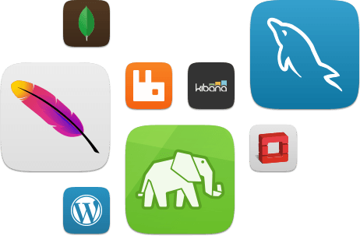
Charms are the building blocks of Juju models
Notes:
Just as Integrated Circuits are the tested understood components of Electrical Engineering, Charms are the reusable components of modeling software.

Slide 24
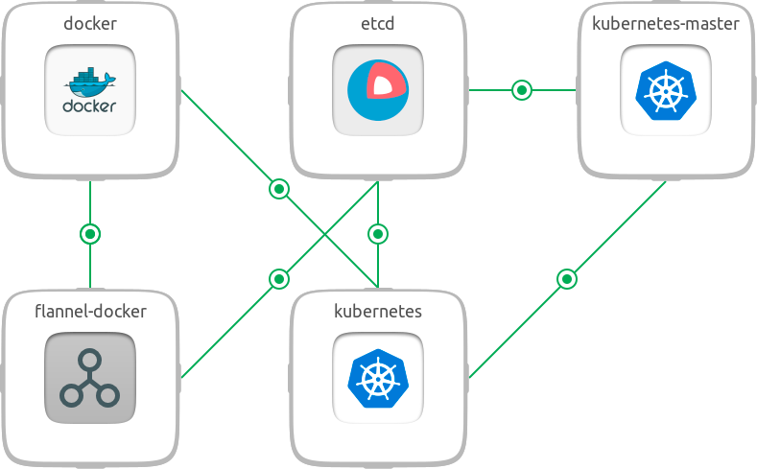
to build application models
Notes:
Here is a fairly simple model of a Kubernetes cluster that I have been working on.
It models 5 services but some of them are on the same server.

Slide 25
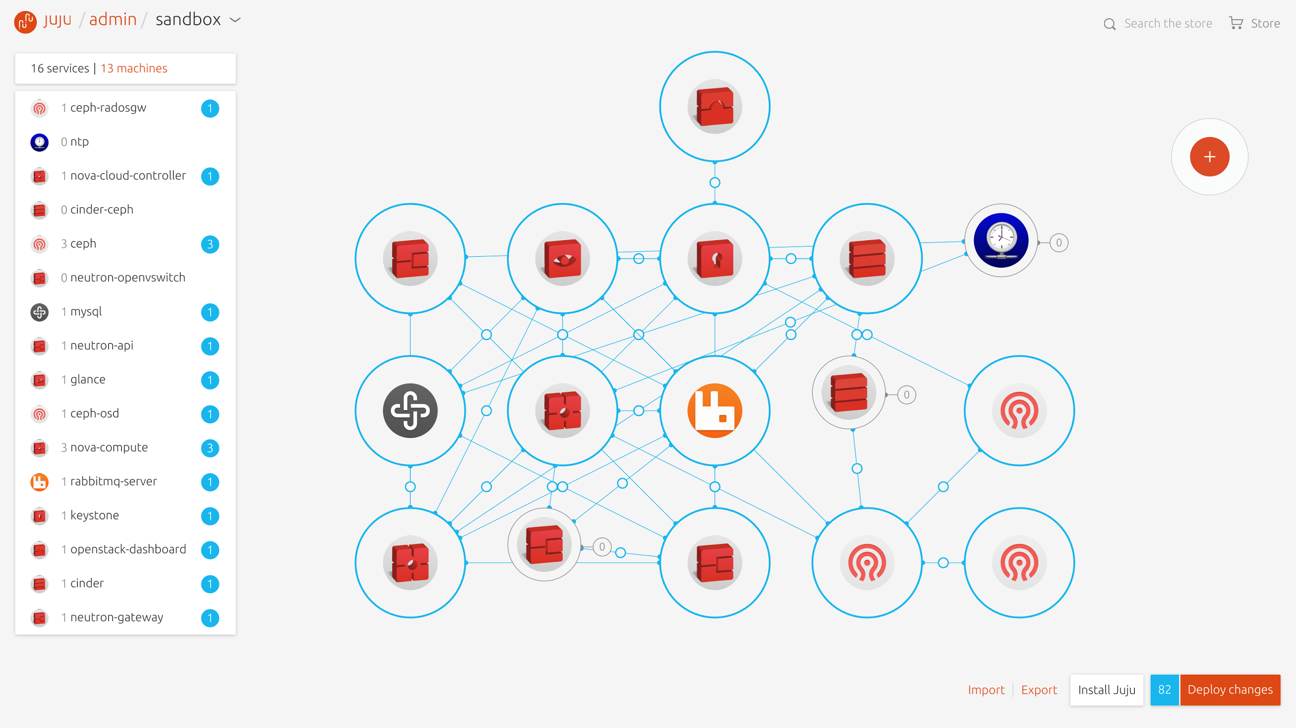
Notes:
Or more complex models.
This model represents Open Stack. For those that don’t use Open Stack it consists of many separate applications that can be run independently or in some cases together.
You might notice at the top that this particular Open Stack model has 16 services running on 13 different machines. Even though this looks complex, this is easily deployed via a model because the individual software pieces contain the operations. Which is to say the charms has code that runs when you connect it to another application.
We will focus on the charm in the center. That is RabbitMQ it is a messaging application that send messages to many different pieces. We use RabbitMQ outside of Open Stack so it is a pretty good example of a charm with robust operations.

Slide 26
A charm contains more than operations
Raw materials
Puppet, Chef, Bash scripts
Tarballs, Zipfiles, JARs
PyPI, NPM, Gems
Golang builds
Docker images
KVM or Hyper-V images
Operations
Install & remove software
Replication, HA, Scale-out
Status changes & messages
Integration
Firewall management
Notes:
A charm contains the operations to install and remove the software, but it may also contain the software package itself, whether it be a Zip file of compiled binaries.
The operations are independent of other charms, so they can be using different languages to install, configure and connect with other charms. So charm authors can write the charm in any language they know. Already have a puppet manifest? That will work.

Slide 27
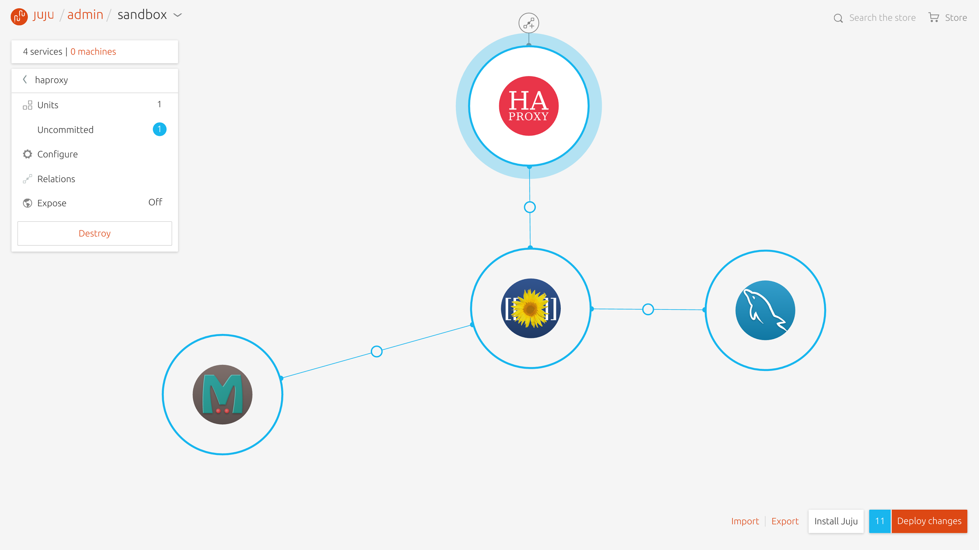
Charms encapsulate application operations
db
installation
configuration
connections
upgrades and updates
scale-out and scale-back
health checks
operational actions
benchmarks
Notes:
When you support customers using your software. Would you rather support someone who deployed it with a repeatable script, or by hand?
Juju doesn’t do the configuration management, but it fires events to let the charms do the config management on their own. In a way that makes sense for that software. If you want to use Chef solo or Puppet and that works, go ahead.

Slide 28
Charms declare “interfaces”
“provides mysql”
db
app
http-proxy
dbslave
memcache
mysql relation
mysql
mysql
jifs
syslog
“requires mysql”
syslog
Notes:
Provides means the charm produces that capability.
Requires means a charm consumes that capability.
There is code on either charm that knows what to do with the information.

Slide 29
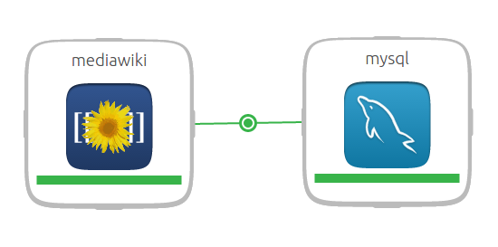
Charms are connectable
mediawiki requires a database, mysql provides a database
Notes:
mediawiki <--> mysql
Relations are bi-directional communication between two charms.
mediawiki.db-relation-joined: “Hello, my IP address is 1.2.3.4. I would like a database please”
mysql.database-relation-joined: “Hello, my IP address is 5.6.7.8. Let me create you a database now”
*some work is done*
mysql.database-relation-changed: “Your database is named ABC, and the user is DEF, the password is XYZ”
mediawiki.database-relation-changed: “Cool, I will put that in my config file.”

Slide 30
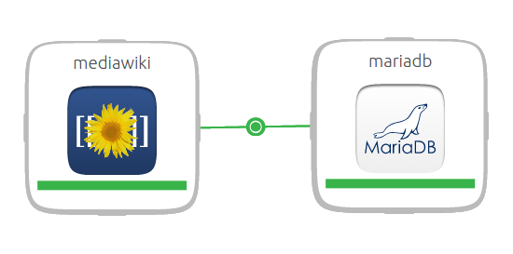
Charms are interchangeable
mariadb also provides a database
Notes:
Since mariadb is a fork of mysql it speaks the same language. These charms are interchangeable. You can try out different forks to see what works best for your application or situation. As easy as a few clicks or some keystrokes.
Juju also has a concept of benchmarks, you can measure what works best for your application by creating a benchmark. Run the benchmark and measure the performance of each change or on different clouds!

Slide 31
Event handling is done in “hooks”
build
install
upgrade health
syslog-relation-join syslog-relation-leave mysql-relation-join
mysql-relation-leave
slave-relation-join slave-relation-leave scale
stop
db
app
build
install
upgrade health http-relation-join http-relation-leave
mysql-relation-join
mysql-relation-leave
memcache-relation-join memcache-relation-leave jifs-relation-join jifs-relation-leave scale
stop
mysql
mysql
Notes:
A hook is a very generic way of saying an event happened and the charm code should react to it.
Juju runs the hooks automatically when lifecycle events occur.
Hooks are the reason you can write your charm in any language. They are simply executable files in a specific structure. The file could be a bash script, or a compiled executable. It just has to run properly and like all Linux processes return 0 if successful or 1 if an error occurred.
This is just an example of some hooks.

Slide 32
Model simply describes complex topologies
cms
logstash
db
hadoop
Notes:
We have seen some examples of complex topologies already, but think of the possibilities with a tool like this! If you are usinga cloud your resource pool is only limited by your accounting department.
Modern software is complex and interconnected. I have a friends that are working on Artificial intelligence, that takes more than just one computer, more than a whole rack of computers.

Slide 33
Apps can be scaled across many “units”
db
cms
machine:1 machine:3 machine:6 machine:7
machine: 9 machine: 16 machine: 8 machine: 5
peers
counterparts
Notes:
Some modern software that runs on different processes can talk with their peers or counterparts.
They can behave differently if they know there are others out there.
Examples:
mysql in master and slave mode, to replicate the database.
Many web apps use stateless HTTP protocol so they can be deployed many servers to balance the load.

Slide 34
Juju designates “leader” units for each app
db
cms
Notes:
Software that has peers or counterparts often need to do things for the other units.
Juju designates one unit as the leader so it can do this for the counterparts.
This is a very useful feature that I have used often. It saves us from having to implement complicated protocols (raft or paxos) to figure out leadership.
This is all I wanted to say about charms, what do you call a collection of charms?

Slide 35
bundles are the model
bundles are a static representation of the model
Notes:
So you have a model, that is great, but what good is it if you can’t share it?
Bundles are simply a file that captures the model.

Slide 36
bundles are:
A collection of charms
A list of relations
The constraints of the systems
The configuration of the charms
A bundle can be deployed in a single step.
Bundles allow easy repeatability, and a way to share complex models with other people.
Notes:
Bundles define the charms, the relations, the constraints, and configuration of a deployment, all in a human readable yaml file.
Bundles do not describe the environment you are currently in so you can take a bundle developed on a laptop and deploy it to a real cloud environment.

Slide 37

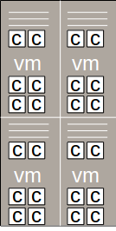
to the Cloud!

Slide 38
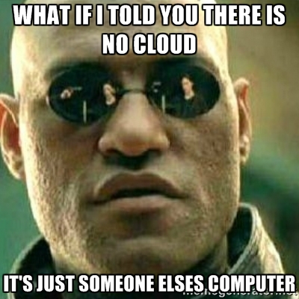
Notes:
The cloud is really just someone else’s computer. You pay them to use them.

Slide 39
cloud computing
resources have gone from scarcity to abundance
Notes:
Only a few years ago if you needed more computers you would order them they would get racked up and about a month later they would go on-line.
I am just talking about Infrastructure as as Service (IaaS) here.
IaaS cloud computing offers computers (physical or virtual) for a very basic service model. These systems are often limited or charged by resources such as CPU, Memory, Network, and Disk.
Anyone with a credit card can now start up as many computers as they can afford. Cloud computing makes computers and resources abundant.

Slide 40
with Juju the model is portable
move your application to another cloud
Notes:
You can deploy the models in different clouds. Juju allows modeling the common features of all clouds so the model is portable to all of them.
What clouds can you deploy to? All of them...seriously.

Slide 41
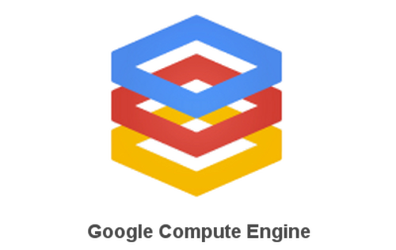






Public Clouds
Notes:
Public clouds provide resources such as applications, storage, or CPU available to the general public over the Internet.
Juju can talk to all the public clouds, giving you the flexibility to use the clouds that you want to use.
One cloud may run your app better or faster.
Another cloud may offer you a lower rate for using them.
No vendor or cloud lock in from Juju!

Slide 42
What if we do not use public clouds?
Got servers? You can deploy to the servers that you already have
Notes:
If you are getting bored because your company does not use cloud computers, hang in there. I am getting to you.
In the case where you don’t rent computers from someone else, you probably have your own computers.
What can we do with those?

Slide 43



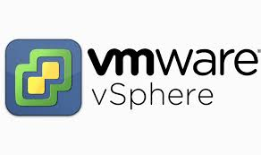
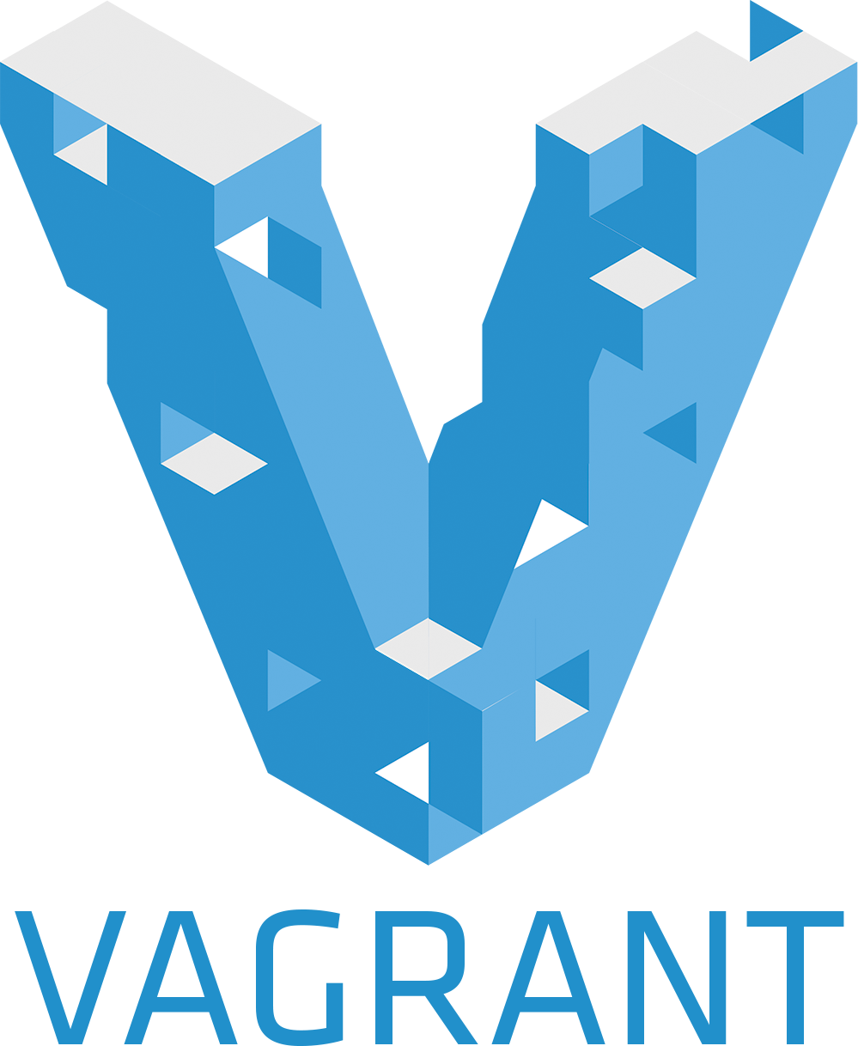
Juju works with bare metal too
Metal As A Service (MAAS)
Linux Containers (LXC)
Notes:
I often use the local provider that uses Linux Containers to make my computer appear to be a small cloud. I use containers because they are faster and use less resources than virtualization. It is roughly 4 times faster to deploy charms on my laptop than in a real cloud. So most of my development is done on local hardware.
Once the model is developed it can be deployed the same commands to any of the other clouds or bare metal. I can share these models with colleagues and we can iterate on developing things much quicker than having everyone install multiple pieces of software.

Slide 44
Juju works with bare metal too
Metal As A Service (MAAS)
Linux Containers (LXC)
http://maas.io
Notes:
Metal As A Service (MAAS) converts your physical machines to a pool of resources that can be provisioned like a cloud. You take advantage of the hardware you already have and have all the advantages of a cloud.
This is really cool. It essentially powers on hardware, and streams an OS over pxe boot to servers under its control.
Automatic (zero-touch) deployment of operating system Ubuntu, CentOS, RHEL and even Windows!
Inventory management
Gives you a REST API, and GUI for your datacenter.
I spoke with a user at the SCALE 14x conference and he had two spare rack servers in his house. He put MAAS on and was running Open Stack on just two servers!
MAAS also works on home pcs, I have MAAS installed on an Intel NUC (next unit of computing) a four inch computer. And it can power cycle the other computers and installs a fresh ubuntu image them when I want.
If your company does not use clouds today you probably have a lot of hardware in your datacenter. Have a look at what MAAS can do, it is pretty amazing.

Slide 45
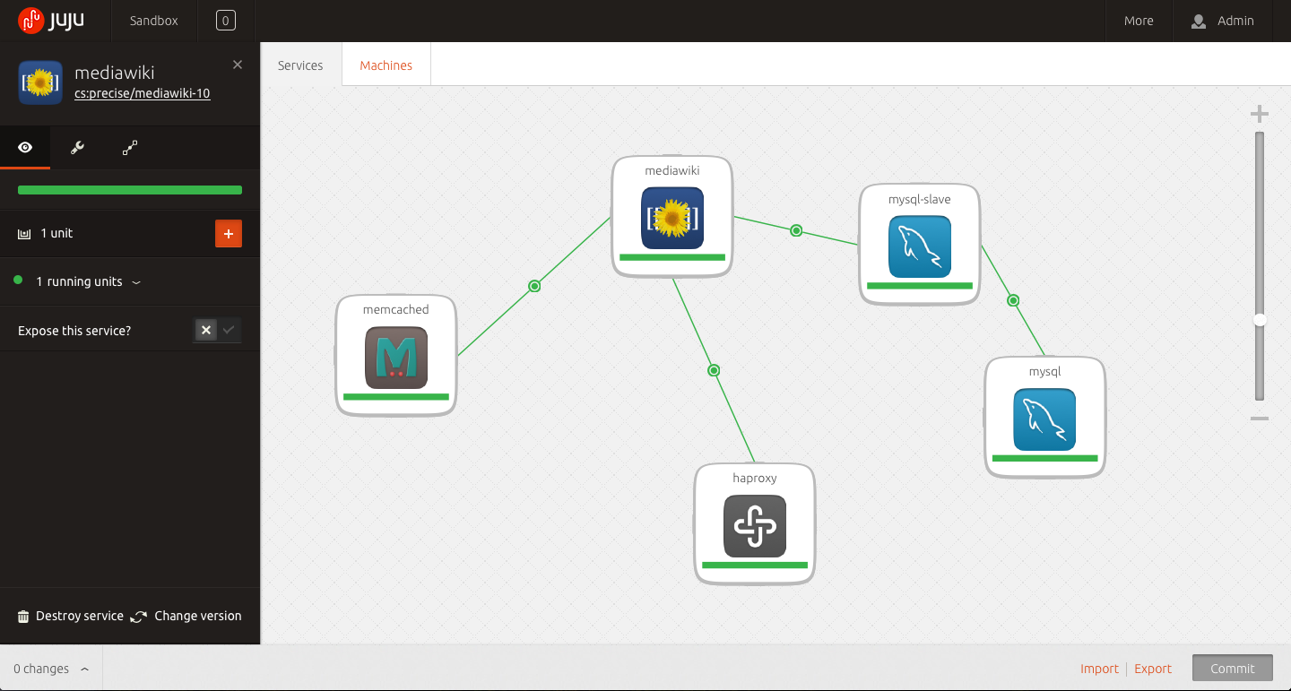
This is what Juju looks like.
The focus is on a collection of services, which have strong brands because the code for them is largely shared across many different communities and companies.
Notice that this picture doesn’t say anything about which cloud or hardware or virtual machines the services are deployed on. In fact, you can’t tell if this topology of services are spread across a single machine, or thousands.
This is purely the logical picture of the services involved in the application, and the relationships between them.
That’s service orchestration. This same picture is true for a dev and test deployment, or a giant production deployment. And all the code between those two scenarios is reusable.
And reusability is incredibly important for you.
Notes:
This is the older style Juju GUI showing a typical web app model.
What you have here:
mediawiki software (very similar to wikipedia)
mysql database software in a master and slave configuration
haproxy is a load balancer that can help distribute the load on ANY web app
memcache d is a in memory cache making things like images load faster
This is a pretty simple model but would not be trivial to set up manually

Slide 46
Notes:
This is a similar model, on the Juju 2.0 GUI.
Moving to a model based approach, you gain the ability to replace components.
Resusable components speak the same language.
Swap others into the model.

Slide 47
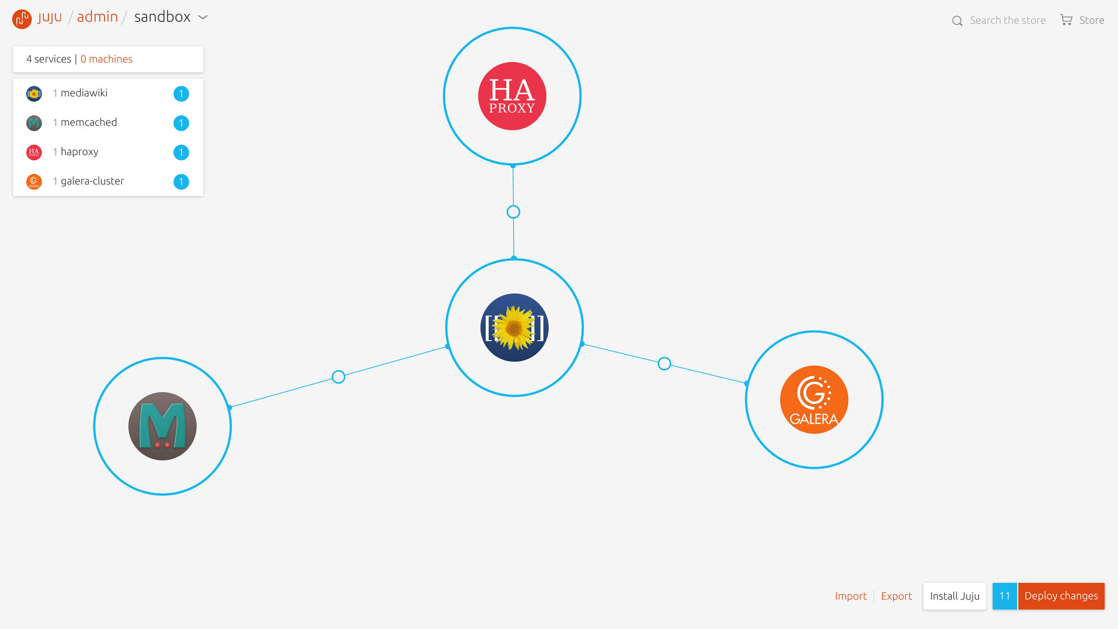
Notes:
Galera is a multi-master cluster based Database with synchronous replication.
Since the galera charm speaks mysql you could use that in you model.
You can try forks of mysql without having to rework other areas of my application.
Other databases are mariadb, that is also a fork of mysql that behaves very similarly.

Slide 48
The modeling language for applications
And an abstraction for network, storage and compute resources
Notes:
The language we use to describe this stuff can be new, but since everyone is starting to realize this it will become common. Just like we talk about classes and objects when describing constructs of software development.
At Canonical we have been working on this problem for about 5 years. We looked very closely at common things people were doing to deploy their solution faster faster and at scale.
Because of the abundance of resources that cloud computing provides us, what matters is what services are involved - not the details of how many machines there are, or which cloud they are on, or whether they are big machines or small machines, or whether all the services are installed on the same machine.
The picture captures the services.
Service orchestration is about focusing on the services, not the machines.
Let software decide what happens on a particular machine, you want your developers to focus on the services independent of the actual implementation.

Slide 49
application modeling
with reusable software components
Notes:
People are doing modeling of one form or another. Just take a look at developer or operations white boards they are drawing boxes and linking them together at scale.
Walk by any engineer’s office and you will see boxes with arrows.
That is a model.
Eventually everyone will be using modeling language to describe their solution.

Slide 50
m1.small
m1.small
m1.large
m1.large
Notes:
Going back to the mediawiki model I shared earlier...
At some point it is useful to understand where the software is actually running. We call this the physical model.
The machine labels happen to be what Amazon calls their instances. So these labels are only relevant for Amazon cloud environments. They describe a different class of instance that Amazon charged for.
m1.small only had one unit of CPU and 1.7 GB of RAM.
m1.large had 2 units of CPU and 7.5 GB of RAM.
You can request different physical characteristics in a generic way to achieve this type of physical model on different clouds.

Slide 51
m1.small
m1.small
m1.large
m1.large
m1.large
m1.large
Notes:
This slide shows how you could scale out this same logical model by giving it more machines.
Some charms can be co-located on the same machine. Increasing density saves money (less machines) and increase utilization of the resources you have.
This is slightly more complicated but again the same logical model, it hasn’t changed.
Showing a difference between the logical model and the physical model.

Slide 52



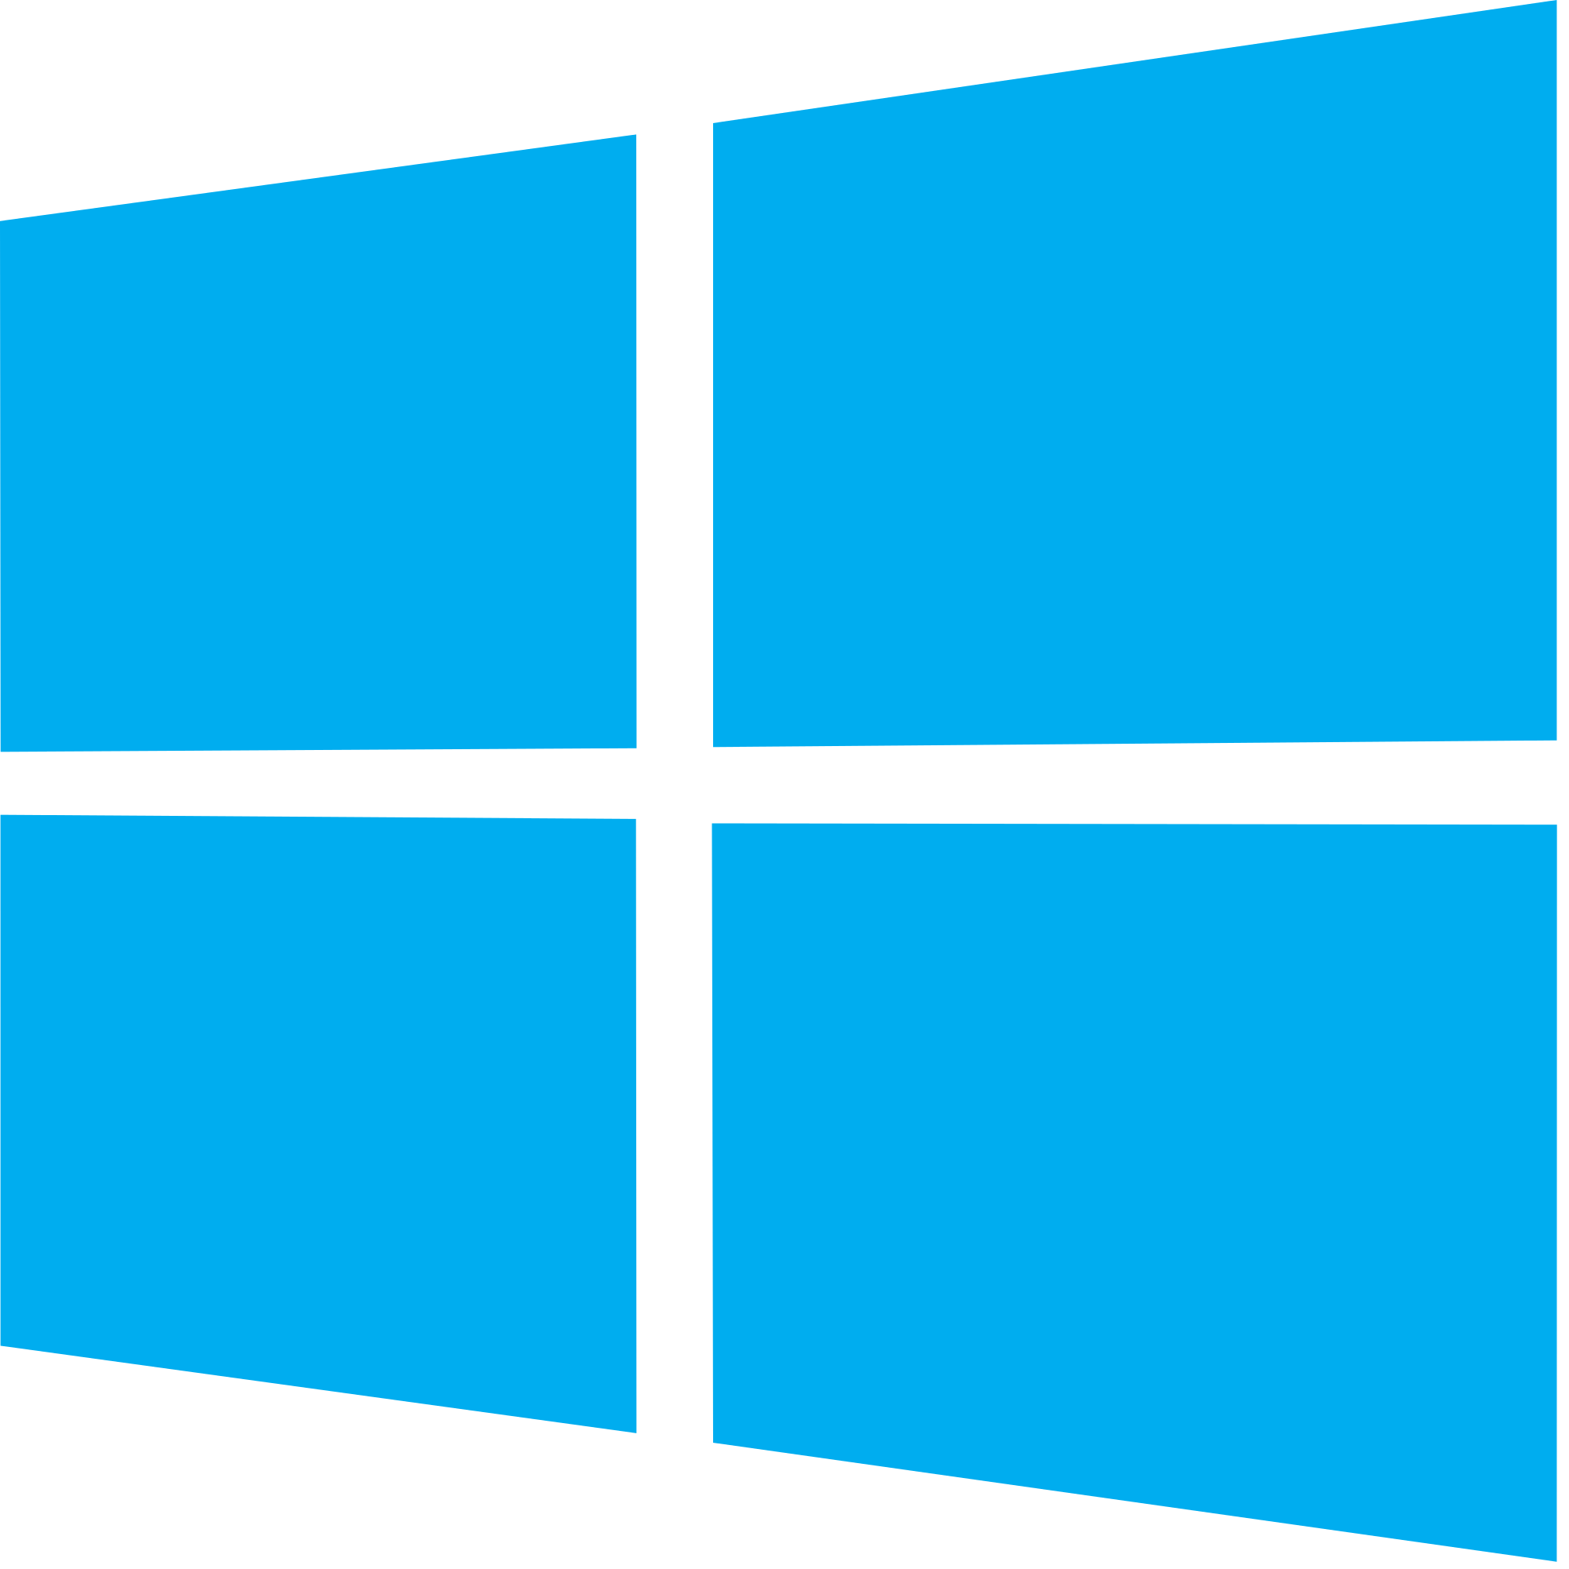
Charms are not only Ubuntu!
Ubuntu workloads
CentOS workloads
RHEL workloads
Windows workloads
That right you can deploy Microsoft services!
http://www.cloudbase.it/juju/
Notes:
Today, you can write charms on Ubuntu, CentOS, Red Hat, or Windows. They are all supported.
So you can weave topologies of software with applications on different operating systems.
Specifically Windows has Active Directory, Exchange Server, SQL Server, and more
We are are also partnering with large companies to model non-free software such as DB2 and Websphere.
No operating system lock in either.

Slide 53
Machines and LXD Containers
5/LXD/2
3/LXD/1
4/LXD/1
5/LXD/1
3/LXD/0
4/LXD/0
5/LXD/1
0
1
2
3
4
5
m1.small
m1.small
m2.large
m2.large
m2.large
m2.large
Notes:
With containers you can create machines within machines.
LXD containers are system level containers, not application style containers like Docker.

Slide 54
Unit colocation or isolation via LXD containers
0
1
2
3
4
5

Slide 55
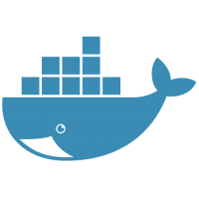
Payloads - Docker or KVM
0
1
2
3
4
5

Slide 56
Stores and Storage Pools
cache
tmpfs ephemeral
content
slow cheap
database
fast expensive
journal

Slide 57
Reusable operational components
Faster. Smarter. Better. Everywhere.
Notes:
Think about the incredible value of reusable operations!
If you get something working for your infrastructure it is probably good enough for others to start using. Other people bring different expertise and value to the table. Each different person contributes back their best practices or knowledge. Crowdsourcing the operations in an iterative process, it gets pretty good.

Slide 58
Story
dev
test
production
collaboration
Notes:
Often don’t realize how we are redoing the same work. This drives my manager crazy.
You may have the same scripts or automation from production to development.
But it may assemble those pieces and parts differently. For instance in production different applications live different servers, but in development every application is run on the developer’s laptop often all hooked up to the same IP address or file system. Think about the problems or bugs that can cause.
We are consistently seeing bugs in distributed applications like Open Stack because for convenience they are running them on one server or system, or process space.
You may not find these types of problem until you hit QA or Production

Slide 59
Reuse across clouds
We have to automate the same thing in many different places
Consider how many different scripts your teams have to do the same thing in different places.
A new developer starts, there is probably a script to setup their laptop or VM to work on a particular project.
There is a different script that will push that code to a test environment, which might be a VM or a local cloud. And a different script to push into production, which might be on bare metal or on a cloud. But if that script only works on one cloud, you’re locked in, so you need to automate the same thing to multiple clouds as well.
Very little of that automation gets reused.
developer laptop
gce / azure
your app
test and dev vm’s
aws
vmware
bare metal
openstack
Notes:
consider a typical in-house application. it needs to be deployable:
on a new developer laptop
on a workgroup test and dev cloud
onto the production infrastructure, which could be
bare metal,
vmware or hyper-v
openstack
or onto any public cloud
but not just one of them, or you are locked in

Slide 60
Reuse across scenarios
Story
LB
FE
App
App
SQL-DB
SQL-DB
KVS
SQL-DB
SQL-DB
Logging
Logging
Big data

Slide 61
beyond automation - reuse & sharing
Automating your ops is OK. Using somebody else’s automation is much better.
You’re probably already automating things so you can repeat them cheaply and predictably. You have scripts for this and scripts for that.
Great.
How many of your scripts did you buy vs build? Probably none. Zero. Zilch. Your modern automations are still in the software stone ages. You’re writing all your own ops.
Perhaps you do it well, perhaps not. The guys who do it probably feel like they are doing it well. But so did the in-house database coder in the 1970’s. Just as you moved to packaaged software, you’re going to move to packaged operations.
You’ll still engineer some of your ops, just like you still write some apps. But only the pieces that really, really matter. For the rest it’s better to be reusing standard open source parts, or operational intelligence straight from the vendor of the application.
Notes:
automation is good, and most people have start automating
but they still have to design and implement each piece from scratch
Share the operations to get a force multiplier of expertise and make use of that knowledge.
People love to talk about immutable infrastructure of containers or other things.
There is a trick in there. It *was* mutated at some point to become immutable.
Where was it modified?
Docker containers can be spinned up in different areas.
It is immutable, but what if you wanted to change it?
Where was the thing born? Can you move that process to the place where you can control it.
Immutability is awkard from a lifecycle perspective.

Slide 62
this is apt-get for the cloud
and it is absolutely amazing!
Notes:
We are building apt-get for the cloud and it is absolutely amazing!
Install software in the cloud, physical hardware, and containers.

Slide 63
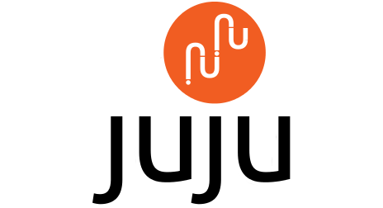
Notes:
beyond configuration management, to service modelling

Slide 64
Demonstration

Slide 65
Questions?
Where to go for more information:
Web site: https://jujucharms.com
The code: https://github.com/juju/juju
Mailing list: https://lists.ubuntu.com/mailman/listinfo/juju
IRC: #juju on freenode.net

Slide 66
Backup slides

Slide 67
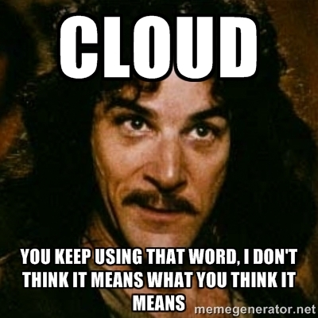
Notes:
Copyright 1999 Princess Bride: “Hello. My name is Inigo Montoya. You killed my father. Prepare to die.”

Slide 68
Cloud types
IaaS
SaaS
PaaS
Notes:
PaaS = Platform as a Service is a category of cloud computing that offers customers a development environment to create, run and manage applications without the complexity of building and maintaining the infrastructure.
IaaS = Infrastructure as a Service offers computers (physical or virtual) and other resources. It is the most basic cloud service model.
SaaS = Software as a Service offers users access to application software and databases. Software on demand, users pay per use or subscription. You don’t install the software on your computer. Think Google, Twitter, Facebook they are all SaaS.

Slide 69
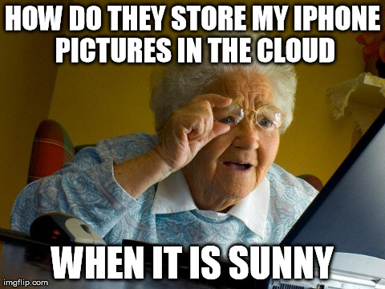

Slide 70
We learn by breaking things
It must be cheap to try things, that may break
Notes:
Models can be deployed in a repeatable and dependable way. If you deploy these models to fast cheap systems you can deploy, break, iterate, and repeat.
My personal experience developing with Juju has been amazing! I can iterate on operations faster than I ever have before, because I am modelling my application with Juju.

Slide 71
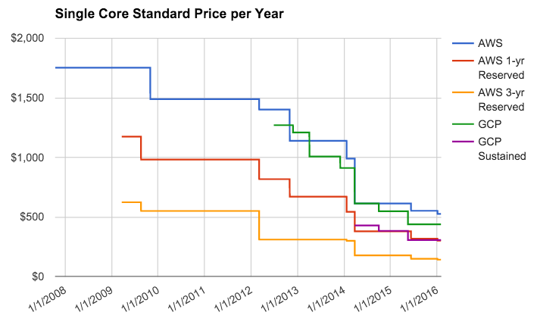
How much does the cloud cost?
Source: https://quizlet.com/blog/whats-the-best-cloud-probably-gcp
Notes:
The price of running a single standard cloud compute core has declined significantly since first introduced. These machines guarantee the user a single cloud CPU with 3.75 GB of memory. The last 3 years have seen GCP's entry into the market. AWS 3-year Reserved Instances remain the cheapest, but are a very restrictive model and involve a large upfront payment. Arguably reserving an instance for 3 years negates many of the benefits of using the cloud at all. Data

Slide 72
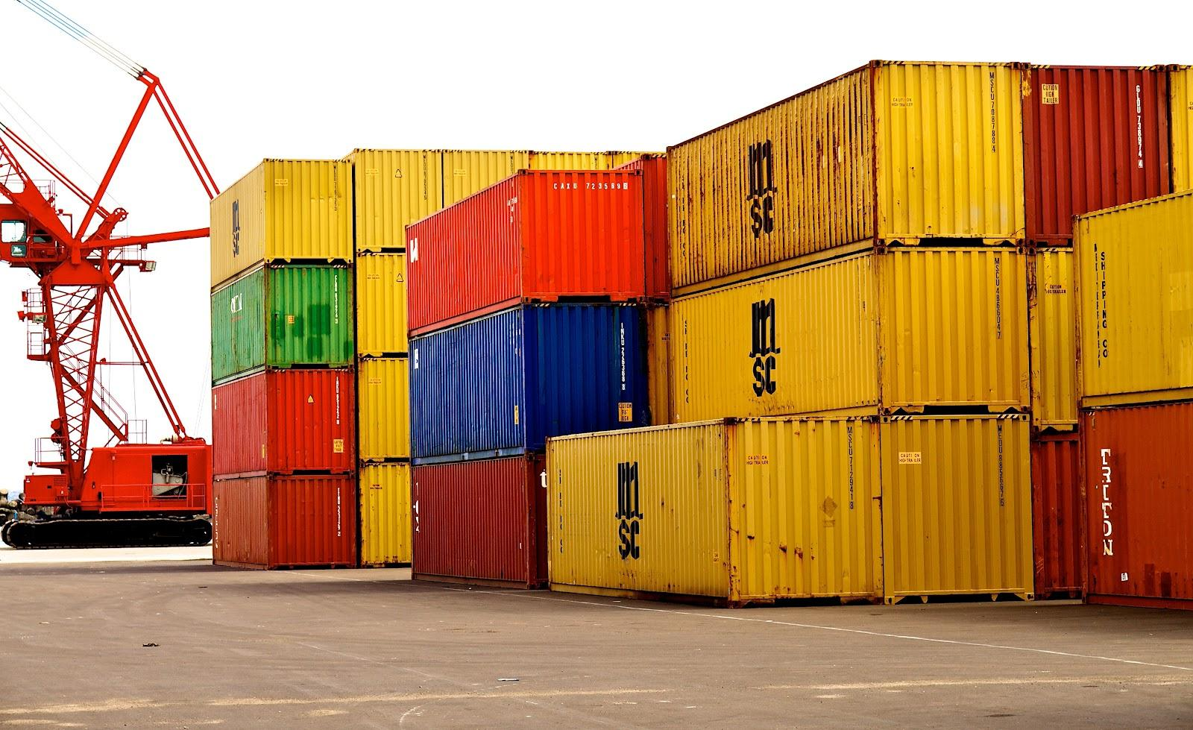
Containers?

Slide 73
Containers
One kernel, multiple isolated processes.
Technology used:
kernel namespaces
cgroups
chroot
Similar to BSD jails
What they are good for:
Isolation
Resource management (CPU, Memory, etc).
Software delivery mechanism
Standardization
Notes:
Software containers are a type of virtualization where the kernel allows for multiple isolated userspace instances.
cgroups = Control groups, a linux feature that has limits (CPU, memory, disk I/O, network, etc).
Namespace isolation = Processes are separated so they cannot see resources in other groups.
chroot = An operation that changes the apparent root directory for a process and its children. The program can not access files and commands outside the directory tree.
BSD jail = Allows an Administrator to partition a computer into several mini-systems called jails. Each jail is separate from each other. The idea being users can not break out of the mini-system.

Slide 74
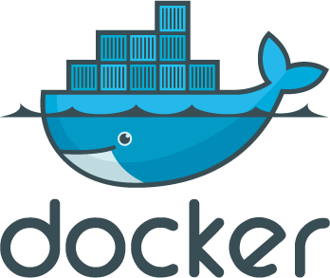

Container technologies
Application containers
One process in per container
System containers
Complete OS in a container, including boot sequence
LXC
Notes:
Application containers contain all the resources needed to run one process on a host.
System containers offer an environment as close as possible to a VM, but without the overhead that comes with running a separate kernel and simulating all the hardware.

Slide 75
Computing infrastructure is only getting more complex

Slide 76

Server
Notes:
In the beginning there was one server, and it was good. Everyone in the company had to share time on the one huge computer.
Vacuum-tube monsters as big as a house.
"I think there is a world market for maybe five computers." - Thomas Watson, president of IBM, 1943

Slide 77
Many servers
Notes:
Many servers are harder to manage. Are the patches up to date? Does each server have different software?
Pets vs. Cattle cliche
Don’t treat your servers differently, so they can all be the same, that is easier to manage. Do not give them cute names or have different install scripts for each one.

Slide 78
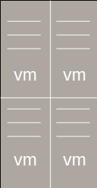
Virtualization
Notes:
Virtualization is making one computer appear to be many. The virtualization processes have some overhead on the host, but gives isolation and separaion of services.
Data centers today use virtualization techniques to make abstraction of the physical hardware, create large aggregated pools of logical resources consisting of CPUs, memory, disks, file storage, applications, networking, and offer those resources to users or customers in the form of agile, scalable, consolidated virtual machines.
Time sharing, multi-programming,
Server Virtualization started back in the early 1960’s and was pioneered by companies like General Electric (GE), Bell Labs, and International Business Machines (IBM). - http://www.everythingvm.com/content/history-virtualization

Slide 79
Containers
Notes:
Containers partition a system into smaller more thin pieces.

Slide 80
Cloud
Notes:
A cloud is someone else running the computers! You pay them for time on their system.

Slide 81
“All problems in computer science can be solved by another level of indirection”
David Wheeler
Notes:
A way of hiding the implementation details of a particular set of functionality, allowing separation of concerns.

Slide 82
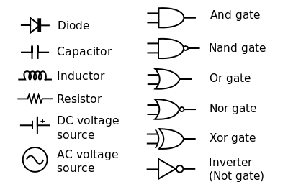
building blocks you might be familiar with...

